Slide 1
Routing
Protocols
(RIP, OSPF, BGP)

Slide 2
CONTENTS
INTERIOR AND EXTERIOR ROUTING
RIP
OSPF
BGP

Slide 3
13.1
INTERIOR
AND
EXTERIOR
ROUTING

Slide 4
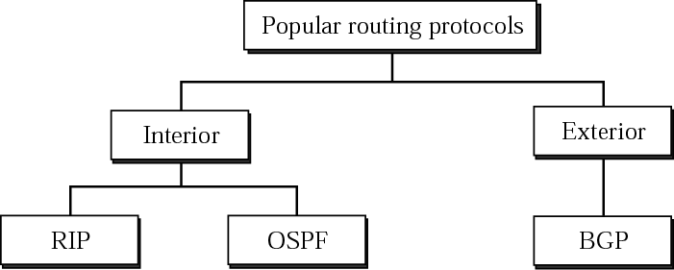
Figure 13-1
Popular routing protocols

Slide 5
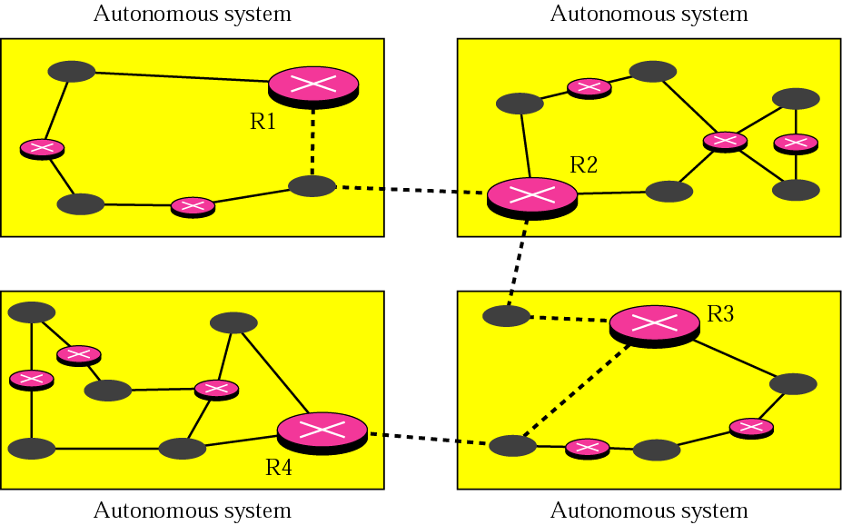
Figure 13-2
Autonomous systems

Slide 6
13.2
RIP:
Routing
Information
Protocol

Slide 7
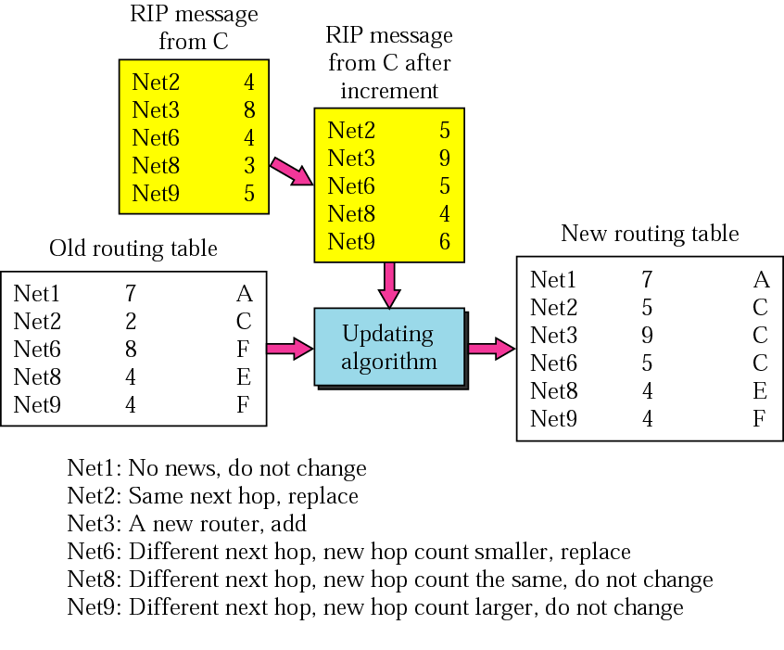
Figure 13-3
Example of
updating
a routing table

Slide 8
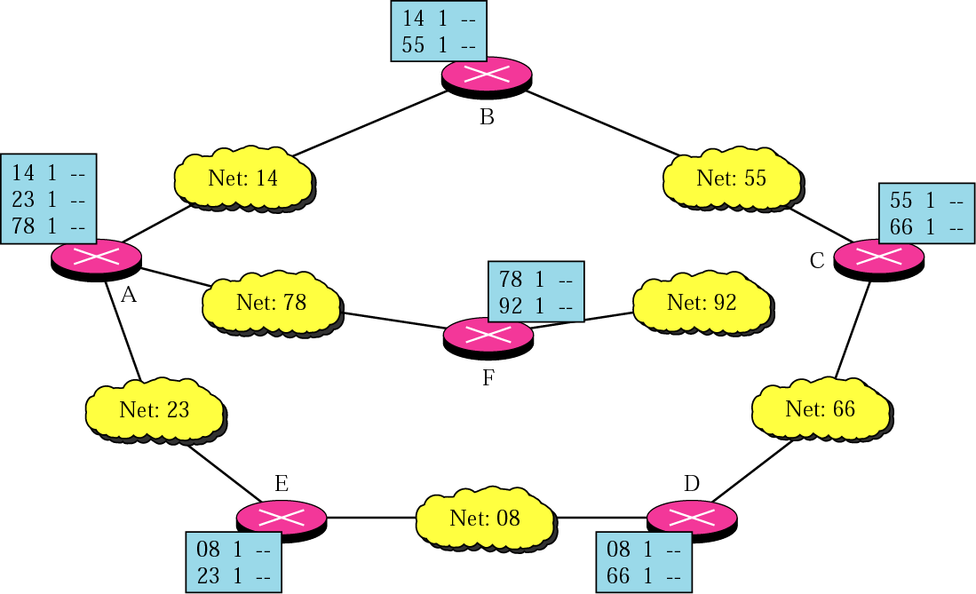
Figure 13-4
Initial routing tables in a small
autonomous system

Slide 9
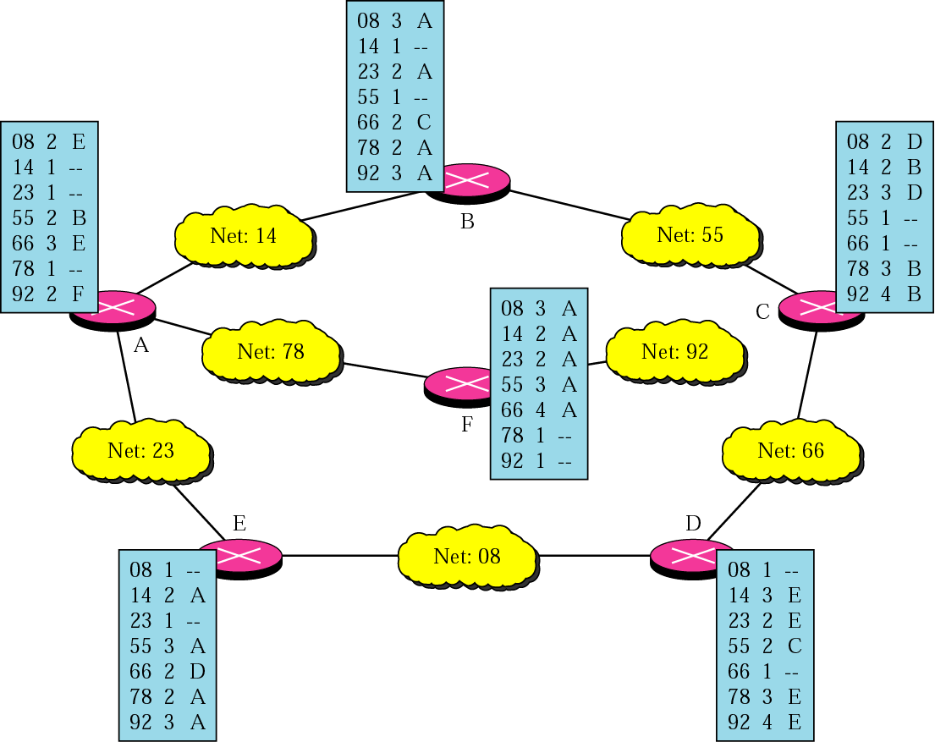
Figure 13-5
Final routing tables for the previous figure

Slide 10
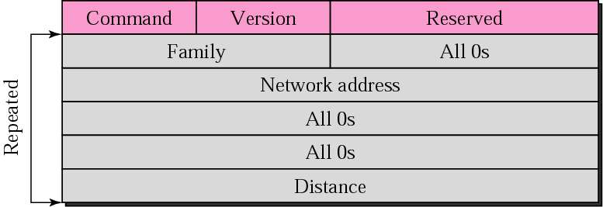
Figure 13-6
RIP message format

Slide 11
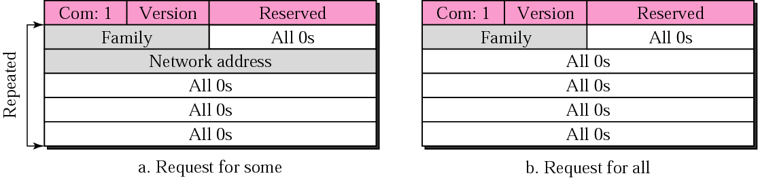
Figure 13-7
Request messages

Slide 12
Example 1
What is the periodic response sent by router R1 in Figure 13.8 (next slide)? Assume R1 knows about the whole autonomous system.

Slide 13
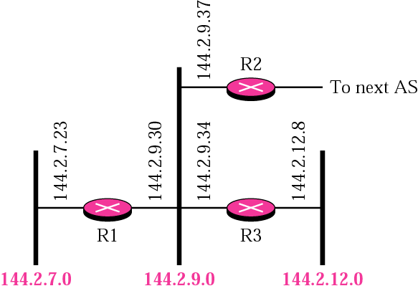
Figure 13-8
Example 1

Slide 14
Solution
R1 can advertise three networks 144.2.7.0, 144.2.9.0, and 144.2.12.0. The periodic response (update packet) is shown in Figure 13.9 (next slide).

Slide 15
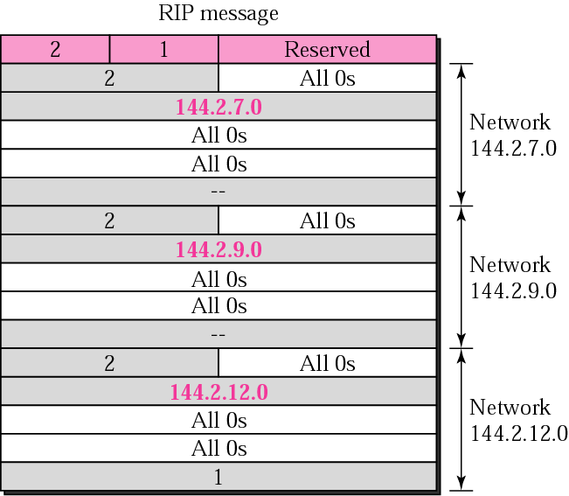
Figure 13-9
Solution to Example 1

Slide 16
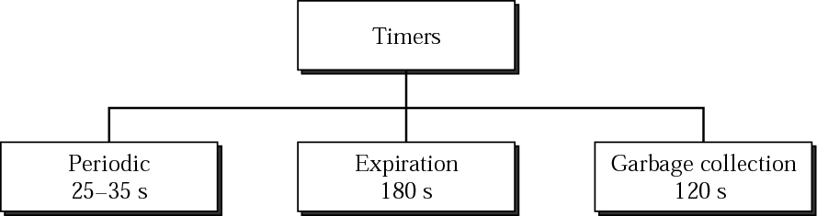
Figure 13-10
RIP timers

Slide 17
Example 2
A routing table has 20 entries. It does not receive information about five routes for 200 seconds. How many timers are running at this time?

Slide 18
Solution
The timers are listed below:
Periodic timer: 1
Expiration timer: 20 − 5 = 15
Garbage collection timer: 5

Slide 19
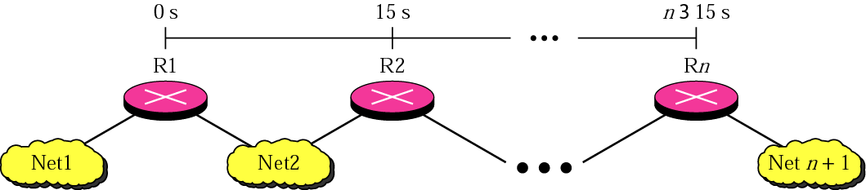
Figure 13-11
Slow convergence

Slide 20
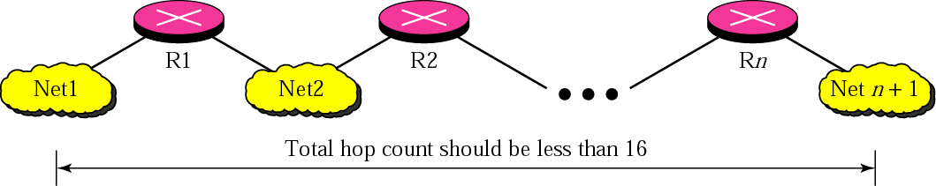
Figure 13-12
Hop count

Slide 21
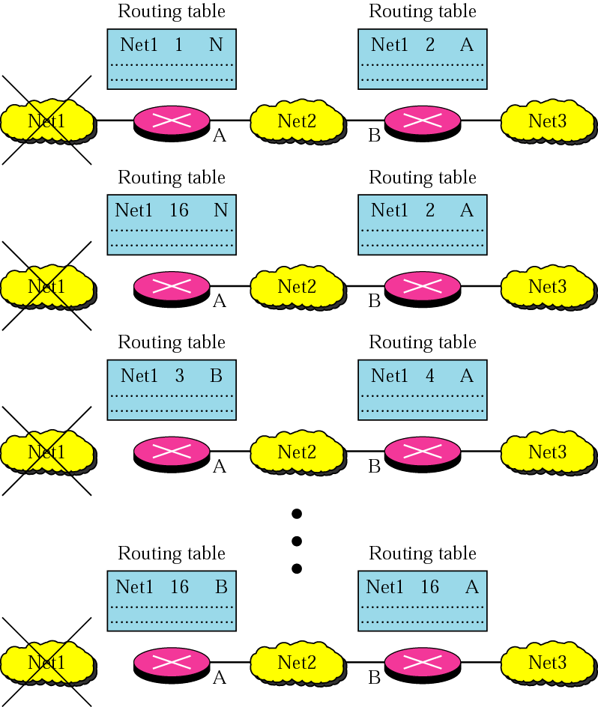
Figure 13-13
Instability

Slide 22
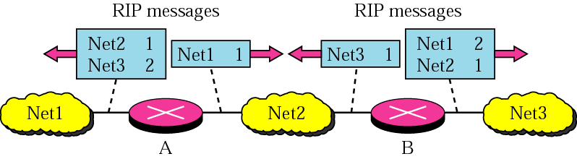
Figure 13-14
Split horizon

Slide 23
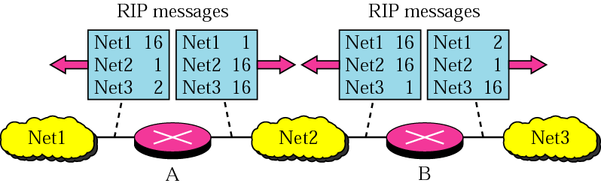
Figure 13-15
Poison reverse

Slide 24
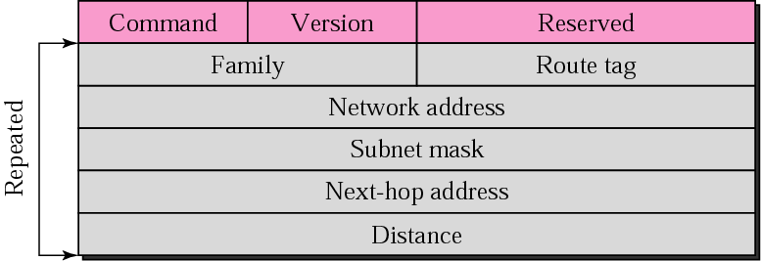
Figure 13-16
RIP-v2 Format

Slide 25

RIP version 2 supports
CIDR.

Slide 26
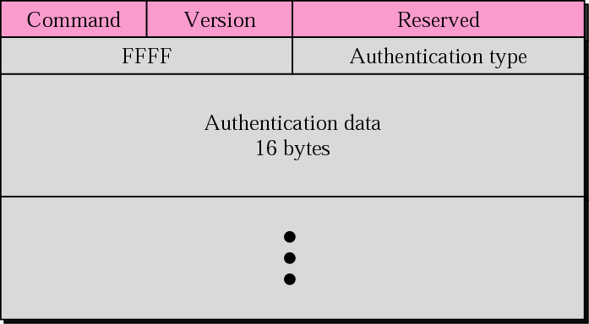
Figure 13-17
Authentication

Slide 27
RIP uses the services of UDP
on well-known port 520.

Slide 28
13.3
OSPF:
Open Shortest
Path First

Slide 29
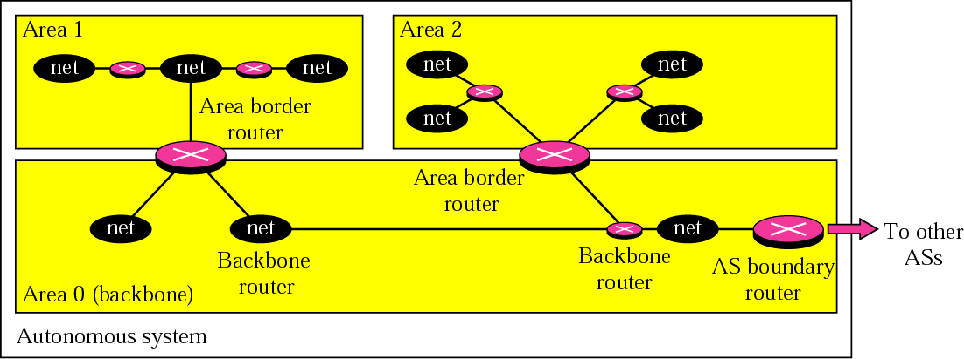
Figure 13-18
Areas in an autonomous system

Slide 30
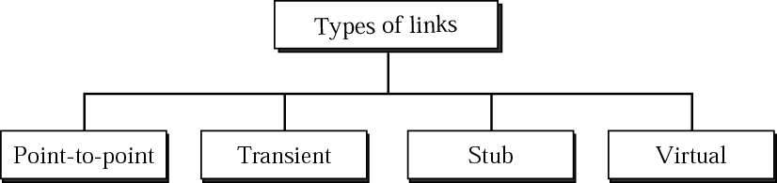
Figure 13-19
Types of links

Slide 31

Figure 13-20
Point-to-point link

Slide 32
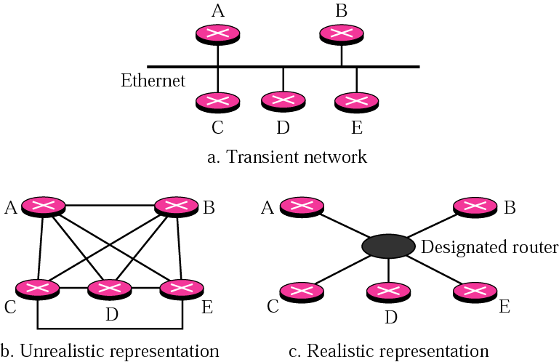
Figure 13-21
Transient link

Slide 33
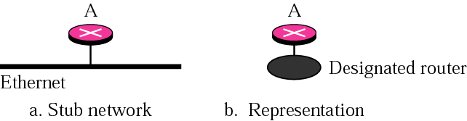
Figure 13-22
Stub link

Slide 34
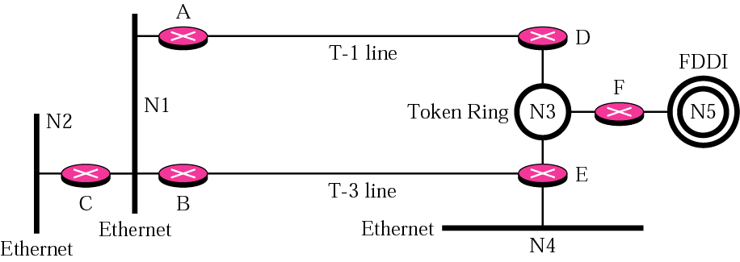
Figure 13-23
Example of an internet

Slide 35
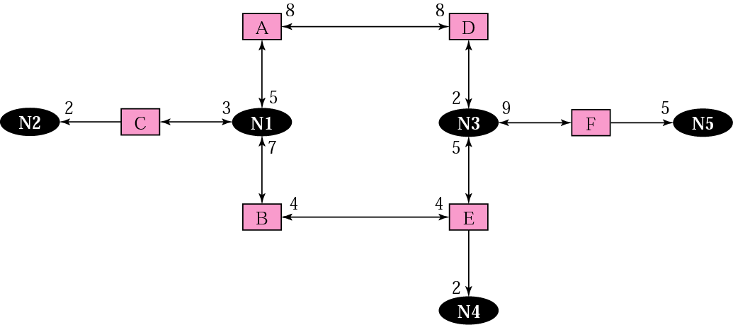
Figure 13-24
Graphical representation of an internet

Slide 36
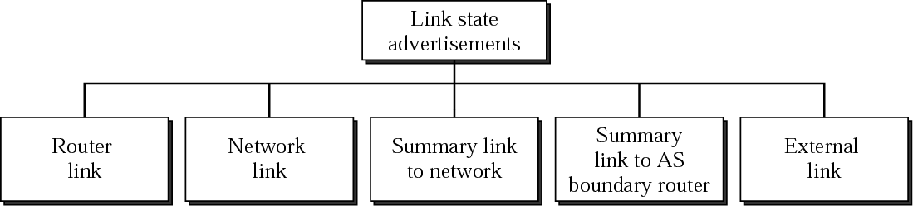
Figure 13-25
Types of LSAs

Slide 37
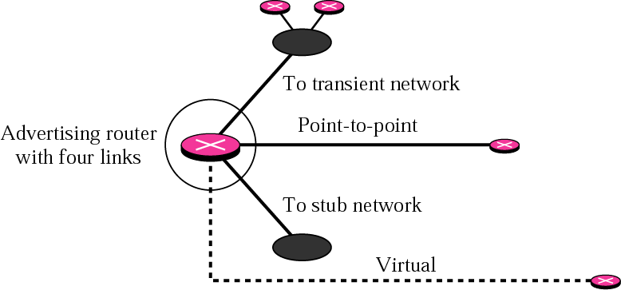
Figure 13-26
Router link

Slide 38
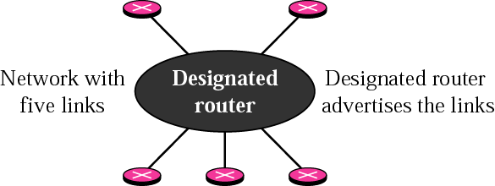
Figure 13-27
Network link

Slide 39
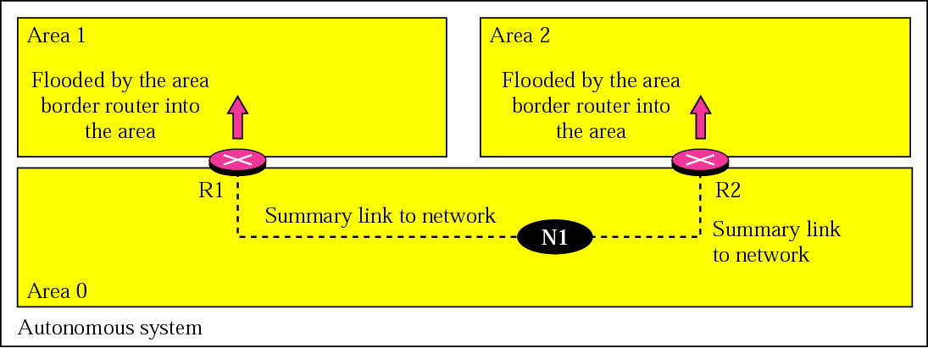
Figure 13-28
Summary link to network

Slide 40
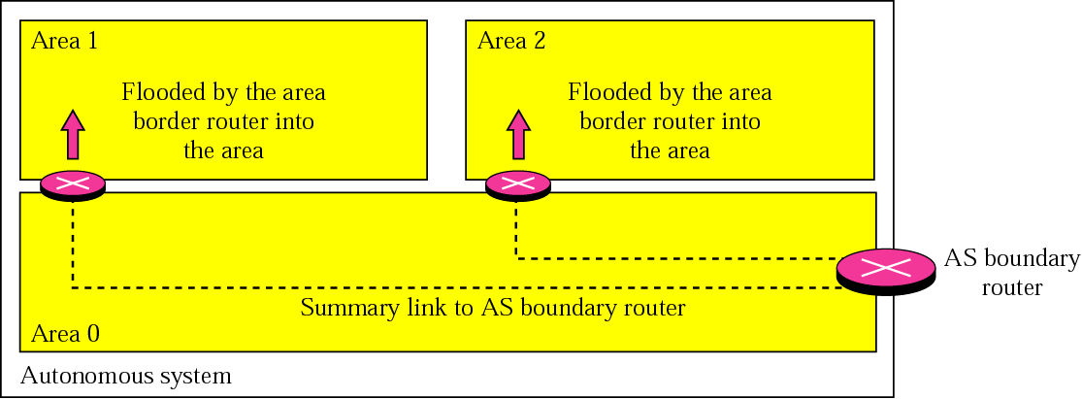
Figure 13-29
Summary link to AS boundary router

Slide 41
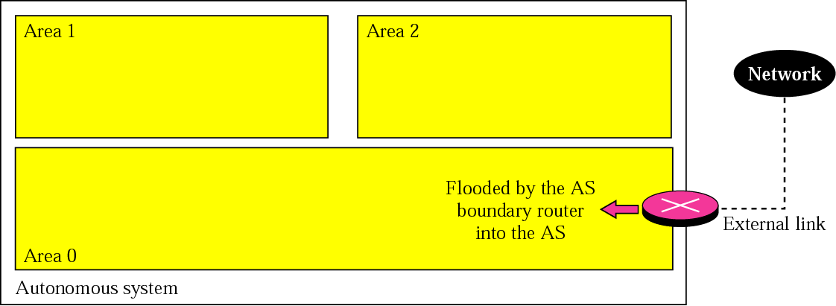
Figure 13-30
External link

Slide 42
Example 3
In Figure 13.31 (next slide), which router(s) sends out router link LSAs?

Slide 43
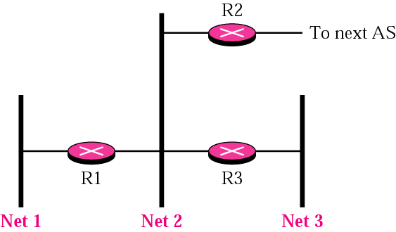
Figure 13-31
Example 3 and Example 4

Slide 44
Solution
All routers advertise router link LSAs.
R1 has two links, Net1 and Net2.
R2 has one link, Net1 in this AS.
R3 has two links, Net2 and Net3.

Slide 45
Example 4
In Figure 13.31, which router(s) sends out the network link LSAs?

Slide 46
Solution
All three network must advertise network links:
Advertisement for Net1 is done by R1 because it is the only router and therefore the designated router.
Advertisement for Net2 can be done by either R1, R2, or R3, depending on which one is chosen as the designated router.
Advertisement for Net3 is done by R3 because it is the only router and therefore the designated router.

Slide 47
In OSPF, all routers have
the same link state database.

Slide 48
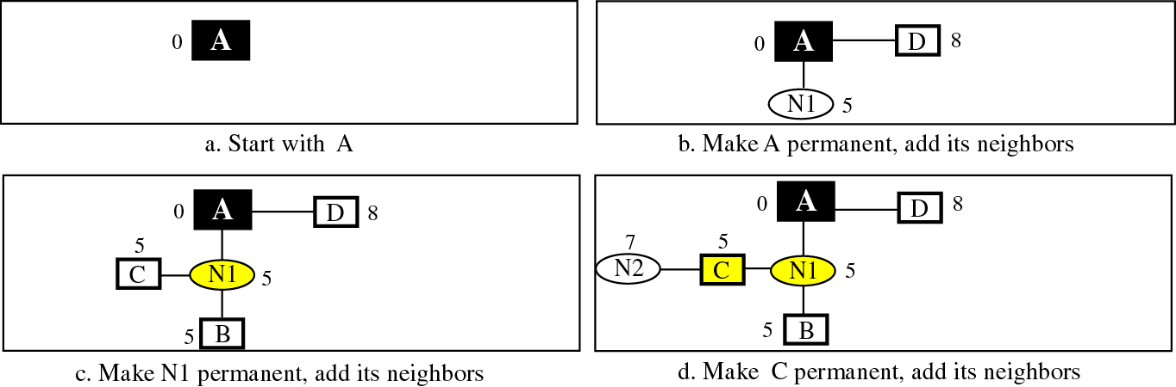
Figure 13-32-Part 1
Shortest path calculation

Slide 49
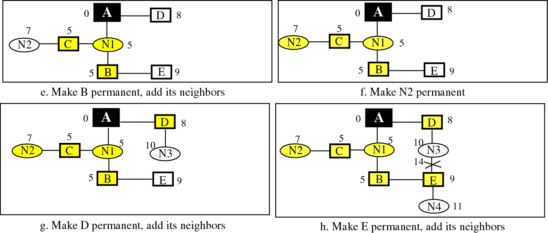
Figure 13-32-Part 2
Shortest path calculation

Slide 50
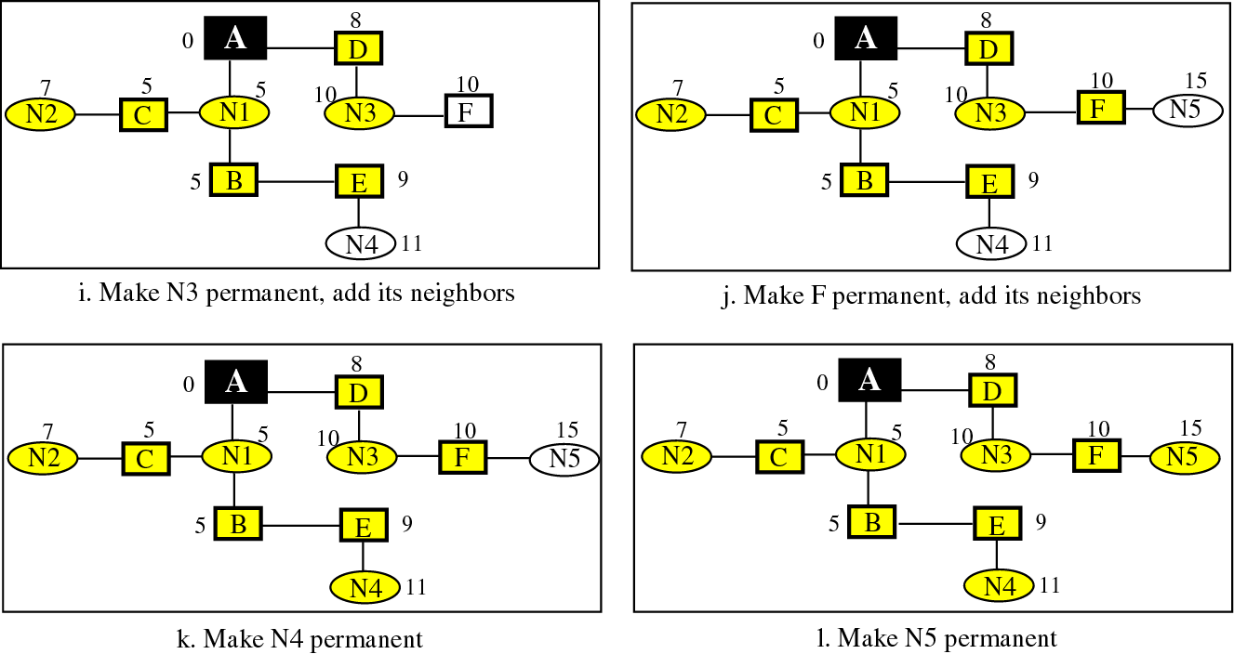
Figure 13-32 Part 3
Shortest path calculation

Slide 51
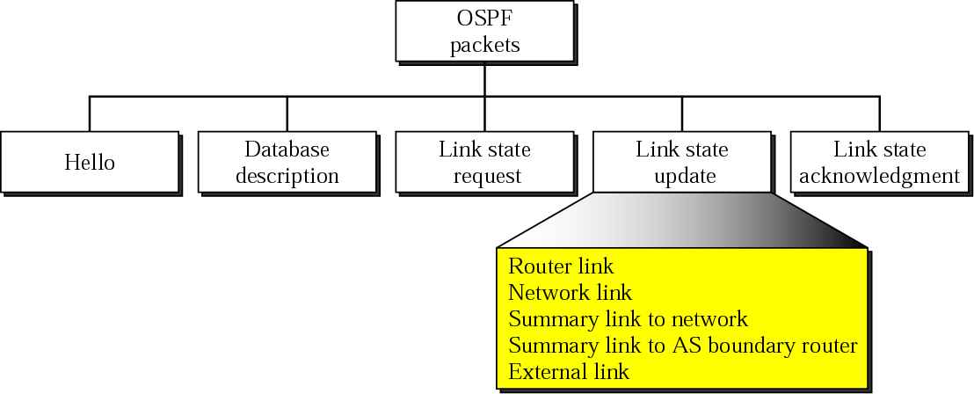
Figure 13-33
Types of OSPF packets

Slide 52
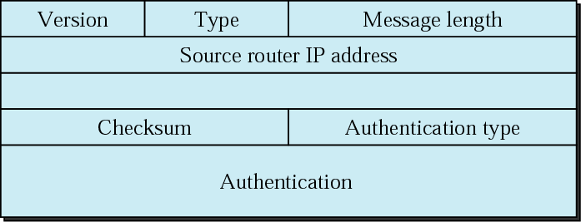
Figure 13-34
OSPF packet header

Slide 53
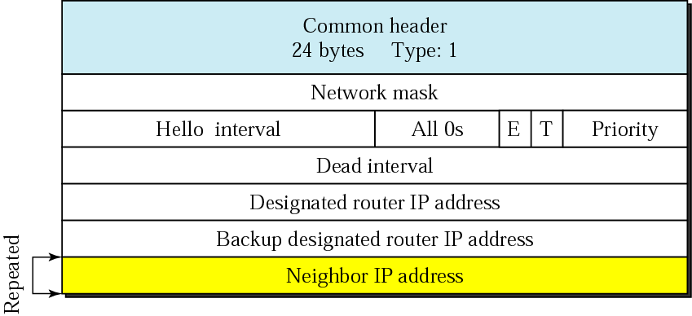
Figure 13-35
Hello packet

Slide 54
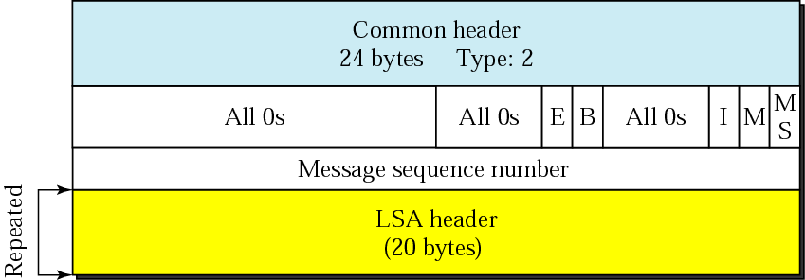
Figure 13-36
Database description packet

Slide 55
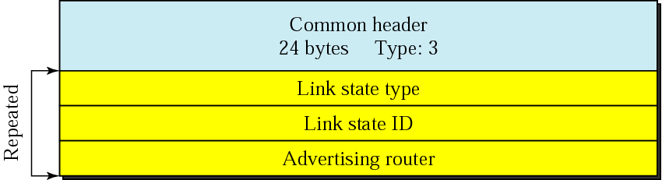
Figure 13-37
Link state request packet

Slide 56
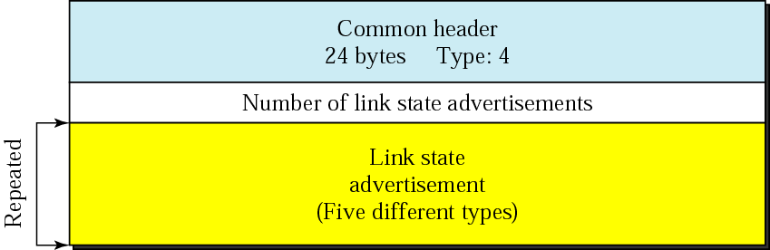
Figure 13-38
Link state update packet

Slide 57
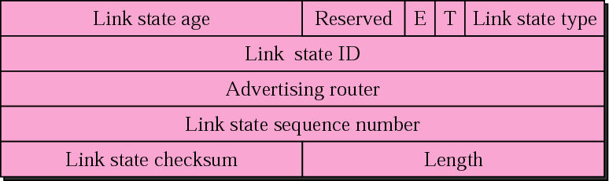
Figure 13-39
LSA header

Slide 58
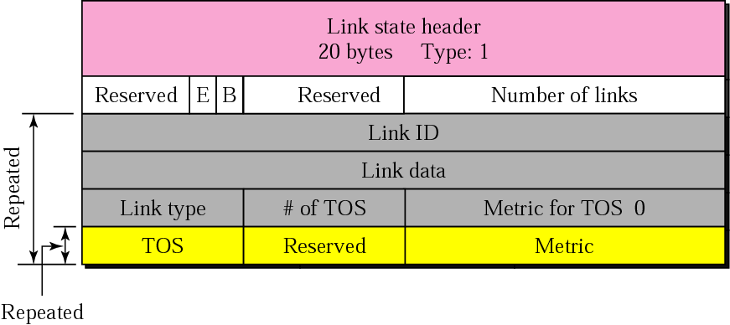
Figure 13-40
Router link LSA

Slide 59
Example 5
Give the router link LSA sent by router 10.24.7.9 in Figure 13.41.

Slide 60
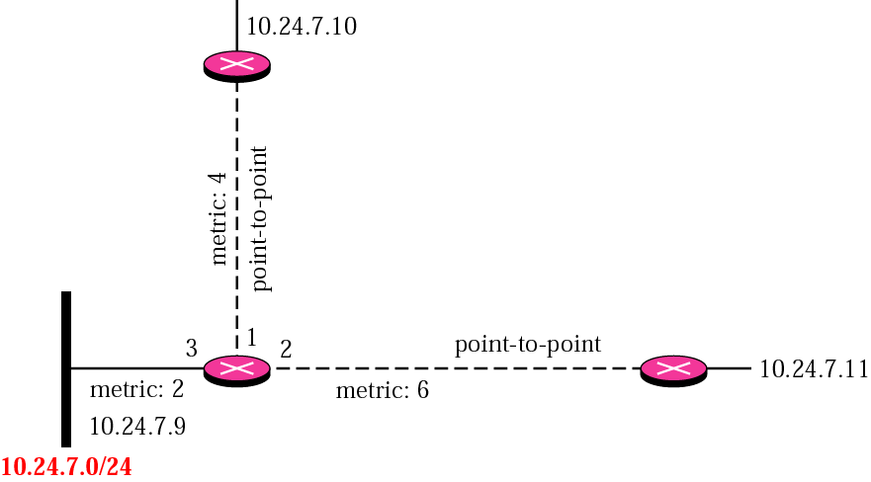
Figure 13-41
Example 5

Slide 61
Solution
This router has three links: two of type 1 (point-to-point) and one of type 3 (stub network). Figure 13.42 shows the router link LSA.

Slide 62
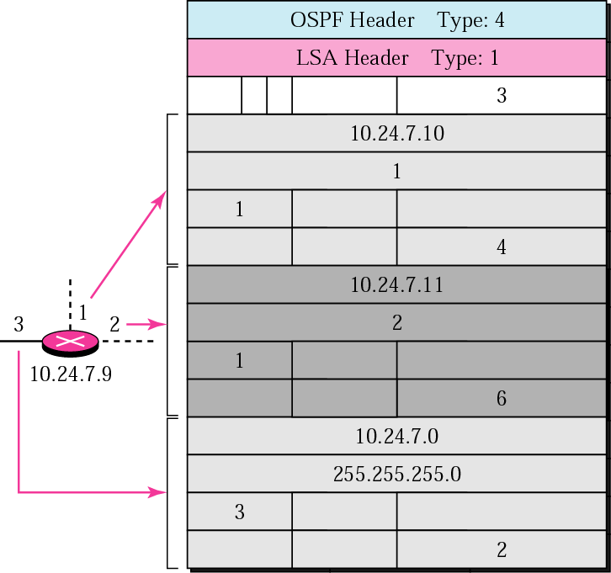
Figure 13-42
Solution to Example 5

Slide 63
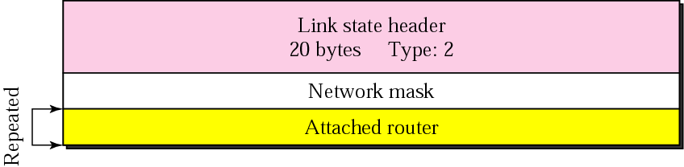
Figure 13-43
Network link advertisement format

Slide 64
Example 6
Give the network link LSA in Figure 13.44.

Slide 65

Figure 13-44
Example 6

Slide 66
Solution
The network, for which the network link advertises, has three routers attached. The LSA shows the mask and the router addresses. See Figure 13.45.
Note that only one of the routers, the designated router, advertises the network link.

Slide 67
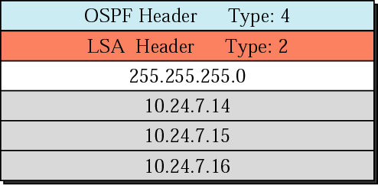
Figure 13-45
Solution to Example 6

Slide 68
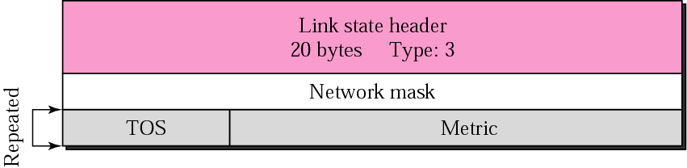
Figure 13-46
Summary link to network LSA

Slide 69

Figure 13-47
Summary link to AS boundary LSA

Slide 70
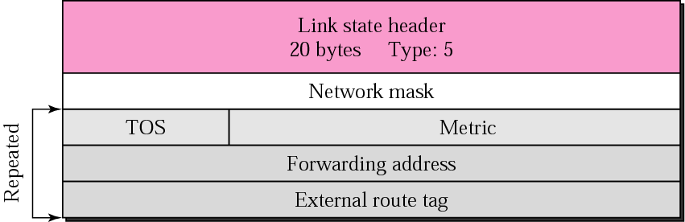
Figure 13-48
External link LSA

Slide 71

Figure 13-49
Link state acknowledgment packet

Slide 72
OSPF packets are
encapsulated in IP datagrams.

Slide 73
13.4
BGP:
Border Gateway
Protocol

Slide 74
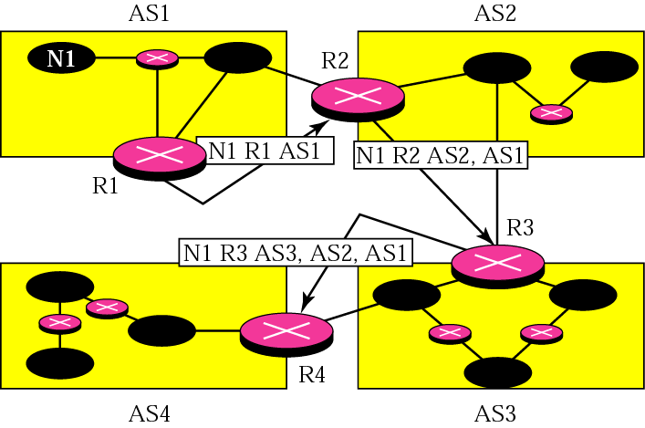
Figure 13-50
Path vector packets

Slide 75
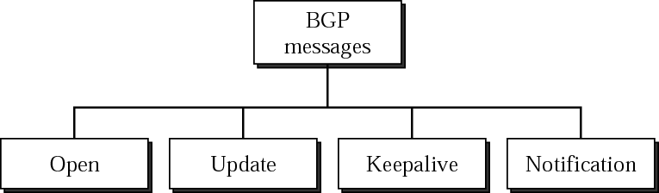
Figure 13-51
Types of BGP messages

Slide 76
BGP supports classless
addressing and CIDR.

Slide 77
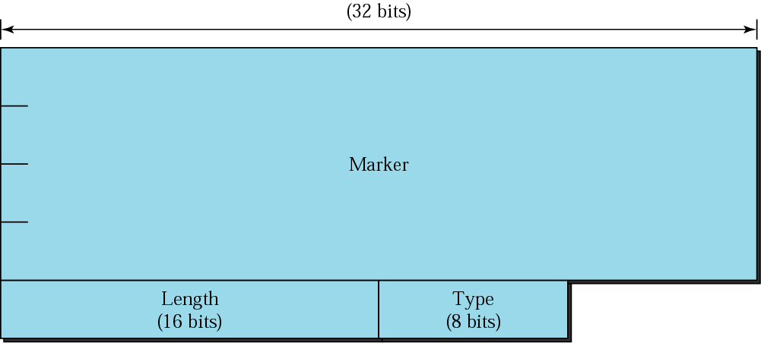
Figure 13-52
BGP packet header

Slide 78

Figure 13-53
Open message

Slide 79

Figure 13-54
Update
message

Slide 80

Figure 13-55
Keepalive message

Slide 81

Figure 13-56
Notification message

Slide 82
BGP uses the
services of TCP on port 179.

